Slide 1

판별분석 개요
Fisher 판별분석 모형
선형판별분석
판별함수 모형 평가
R 선형판별분석

Slide 2
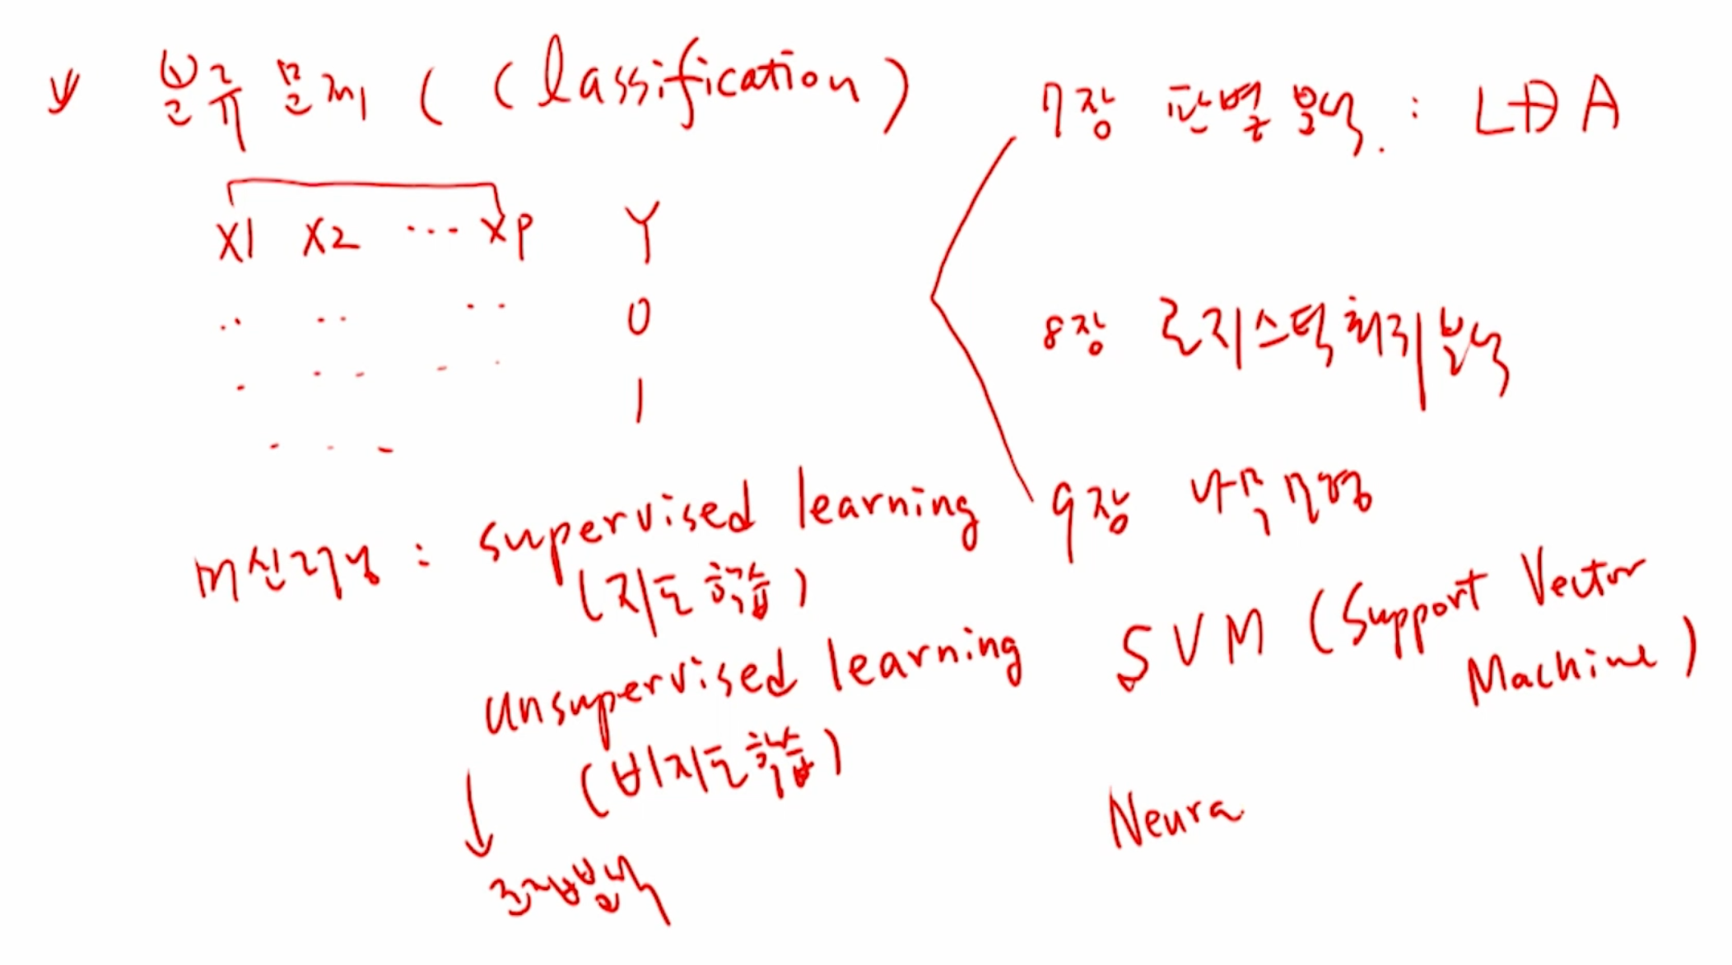

Slide 3



Slide 4
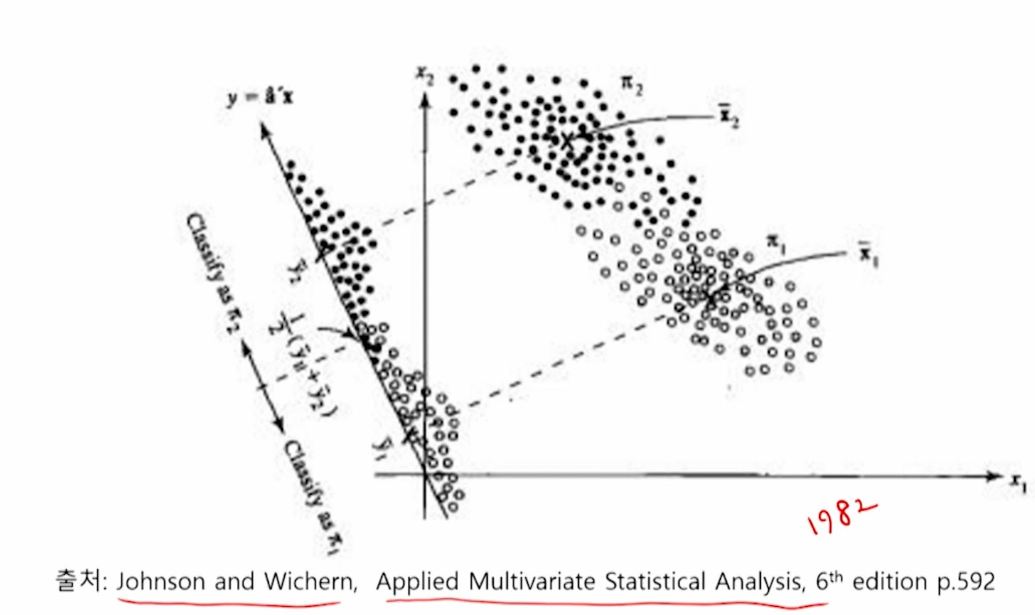

Slide 5


Slide 6


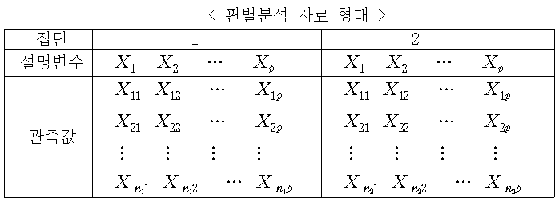
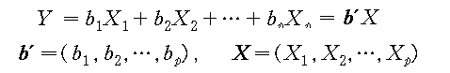

Slide 7

b
b
𝜆 =
b
b = ∑⁻¹(μ − μ )
2 1
Y = b ' X = (μ − μ ) ' ∑⁻¹ X
2 1
−1
Y = b ' X = ( X ₂ − X₁ ) ' S X

Slide 8
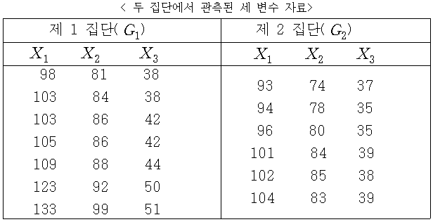
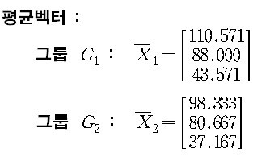
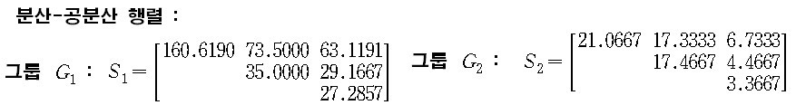
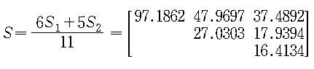

b = S ⁻¹ ( X − X ) = (0.545, −0.558, −1.024) '
2 1
Y = 0.545X₁ − 0.558X ₂ −1.024 X ₃

Slide 9



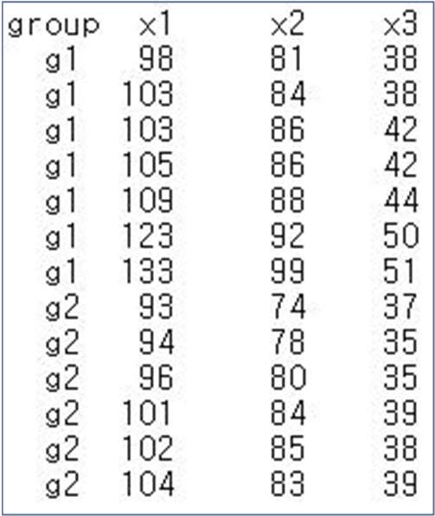
data7 = read.csv("c:/data/mva/data7-1.csv")
head(data7, 3) group x1 x2 x3 1 g1 98 81 38
2 g1 103 84 38
3 g1 103 86 42
data7_g1 = data7[data7$group=='g1', -1]
data7_g2 = data7[data7$group=='g2', -1]
g1_mean = sapply(data7_g1, mean)
g2_mean = sapply(data7_g2, mean)
g1_mean
x1 x2 x3 110.57143 88.00000 43.57143
g2_mean
x1 x2 x3 98.33333 80.66667 37.16667
자료

Slide 10


n1 = nrow(data7_g1)
n2 = nrow(data7_g2)
cov_g1 = cov(data7_g1)
cov_g2 = cov(data7_g2)
cov_g = ((n1-1)*cov_g1 + (n2-1)*cov_g2) / (n1+n2-2)
cov_g
 | x1 | x2 | x3
x1 | 97.18615 | 47.96970 | 37.48918
x2 | 47.96970 | 27.03030 | 17.93939
x3 | 37.48918 | 17.93939 | 16.41342
b = solve(cov_g) %*% (g2_mean - g1_mean)
round(b, 3)
[,1]
x1 0.545
x2 | -0.558 | b = S ⁻¹ ( X − X ) = (0.545, −0.558, −1.024) ' 2 1
x3 | -1.024 | Y = 0.545X₁ − 0.558X ₂ −1.024 X ₃

Slide 11
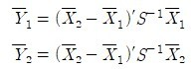
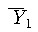
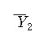
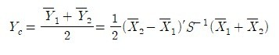
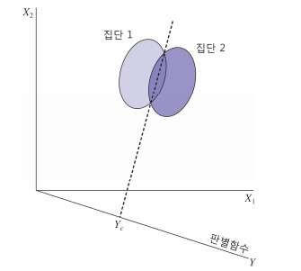
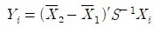
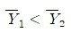
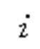


Slide 12


y1_mean = g1_mean %*% b
y2_mean = g2_mean %*% b
y1_mean
[,1]
[1,] -33.51548
y2_mean
[,1]
[1,] -29.52853
yc = (y1_mean + y2_mean)/2
yc
[,1]
[1,] -31.52201
case1 = data7_g1[1,]
case1 = as.matrix(case1)
y1 = case1 %*% b
y1
[,1]
1 -30.74943
y1 = -30.75
yc = -31.52
▪ => yc < y1 이므로 그룹 2로 분류됨.
>

Slide 13



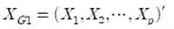

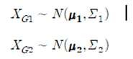


Slide 14

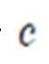


Slide 15


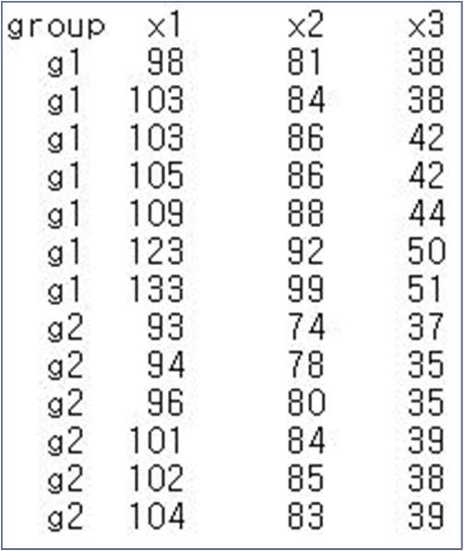
library(MASS)
data7 = read.csv("c:/data/mva/data7-1.csv")
data7_lda = lda(group ~ ., data=data7)
data7_lda Call:
lda(group ~ ., data = data7)
Prior probabilities of groups:
g1 g2
0.5384615 0.4615385
자료
Group means:
x1 x2 x3
g1 110.57143 88.00000 43.57143
g2 98.33333 80.66667 37.16667
Coefficients of linear discriminants:
LD1
x1 0.2727114
x2 -0.2794634
x3 -0.5128692

Slide 16



pred_lda = predict(data7_lda, newdata=data7)
names(pred_lda)
[1] "class" "posterior" "x"
pred_lda$class
g2 g2 g1 g1 g1 g1 g1 g2 g2 g2 g1 g2 g2 Levels: g1 g2
head(pred_lda$posterior) g1 g2
1 0.3501401 0.64985989
2 0.1588189 0.84118107
3 0.9719480 0.02805197
4 0.9210121 0.07898791
5 0.9689978 0.03100215
6 0.9851558 0.01484415
head(pred_lda$x)
LD1
1 0.4637161
2 0.9888827
3 -1.6215208
4 -1.0760981
5 -1.5699178
6 -1.9470273
# 참고 : 앞의 결과를 이용하여 분류점수 구하기
prior = data7_lda$prior
scaling = data7_lda$scaling
scaling
LD1
x1 0.2727114
x2 -0.2794634
x3 -0.5128692
d_means = data7_lda$means
d_means
x1 x2 x3
g1 110.57143 88.00000 43.57143
g2 98.33333 80.66667 37.16667
means <- colSums(prior * d_means)
means
x1 x2 x3
104.92308 84.61538 40.61538
x = data7[,-1]
dscore=scale(x, center=means, scale=FALSE) %*% scaling
head(dscore, 3)
LD1 [1,] 0.4637161
[2,] 0.9888827
[3,] -1.6215208

Slide 17

library(klaR)
ldahist(pred_lda$x, g=data7$group)
library(klaR)
ldahist(pred_lda$x, g=data7$group)
dev.new()
plot(pred_lda$x, pch=19)
text(pred_lda$x, data7$group, cex=0.7, pos=4)
abline(h=0, lty=2)
identify(pred_lda$x) [1] 1 2 11
1.0
0.0
-2
-1
0
1
group g1
g2
g2
g2
1.0
1
2
g1
g
0.0
pred_lda$x
1
g1
g2
-2
-1
0
1
0
g2
11
group g2
-1
g1
g1
g1
g1
-2
g1
2
4
6
8
10
12
Index

Slide 18


λ =
T
W
T
W
> | x = data7[,-1]
> | head(x, 3)
x1 |  | x2 | x3
1 98 |  | 81 | 38
2 103 |  | 84 | 38
3 103 |  | 86 | 42
data7_man <- manova(as.matrix(x) ~ pred_lda$class)
wilks_test = summary(data7_man, test="Wilks")
wilks_test
Df Wilks approx F num Df den Df
Pr(>F)
pred_lda$class 1 0.16683 14.983 3 9 0.0007604 ***
Residuals 11
---

Slide 19



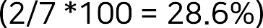
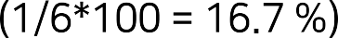

confm_lda = table(data7$group, pred_lda$class)
confm_lda
g1 g2
g1 5 2
g2 1 5
prop.table(confm_lda,1)
g1 g2
g1 0.7142857 0.2857143
g2 0.1666667 0.8333333
error = 1 - sum(diag(prop.table(confm_lda)))
error
[1] 0.2307692

Slide 20




Slide 21
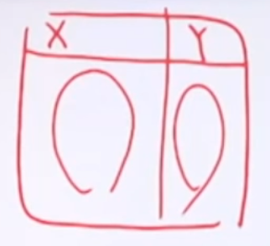


Slide 22



